Slide 1
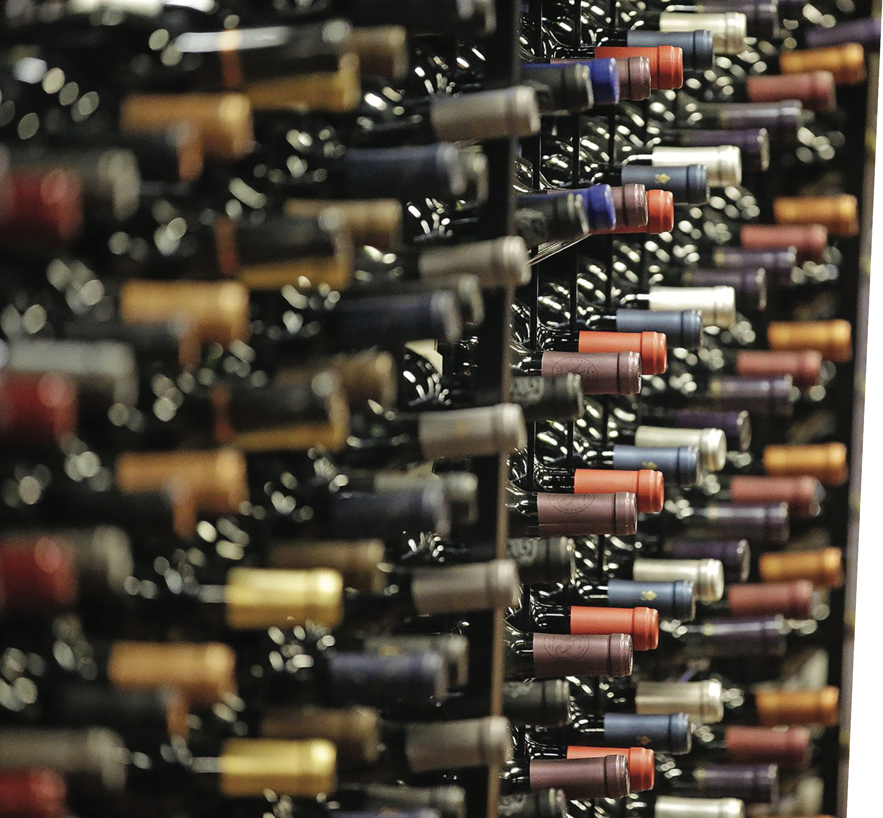

WONDERFUL
WINES
of
the
WORLD

Slide 2
Introduction

Slide 3
Wonderful World of Wine Customers
18
78
1
54
549
Today
$6
$2,938
48
12
52
$622
Age # of Purchases Days Since Purchase Lifetime Value

Slide 4
Data Pre-Processing
Removing extraneous row
Removing outliers
Removing noise identified by DBSCAN
Feature Selection and Segmentation
Dividing features into segments
Removing highly correlated features within each segmentation

Slide 5
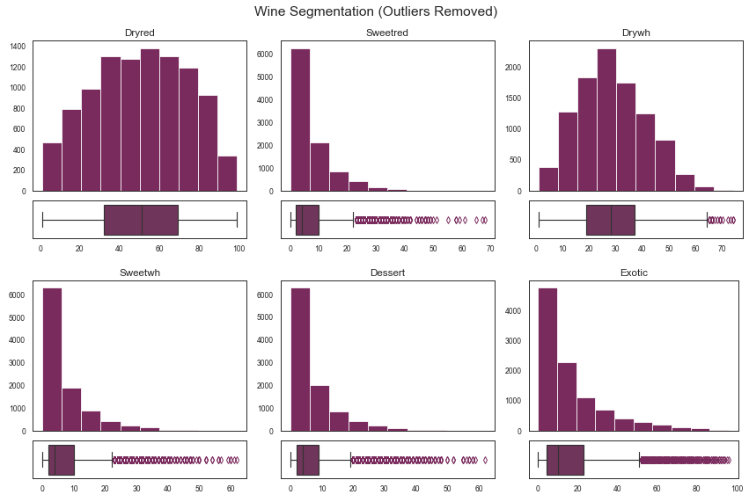

Slide 6
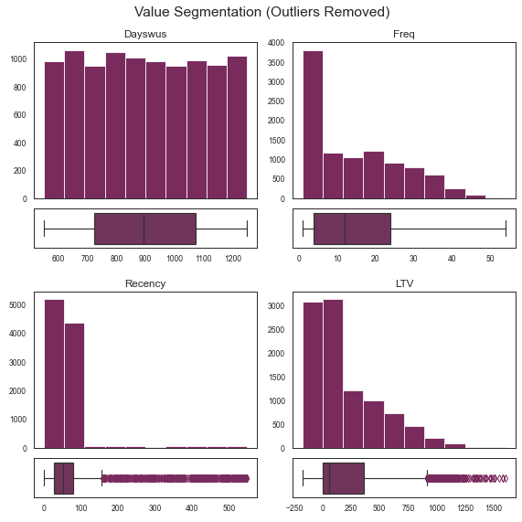

Slide 7
Wine Preferences Segmentation

Slide 8
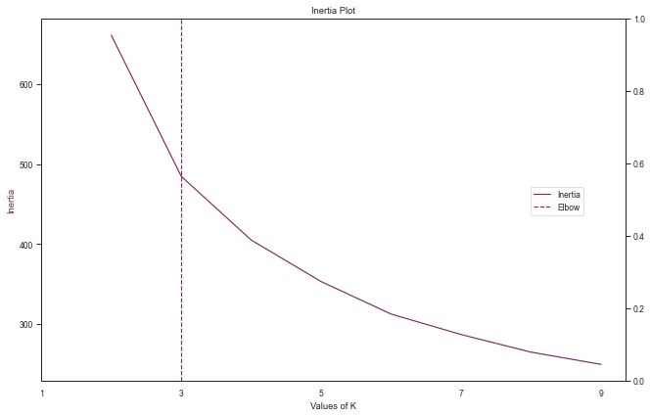

Slide 9
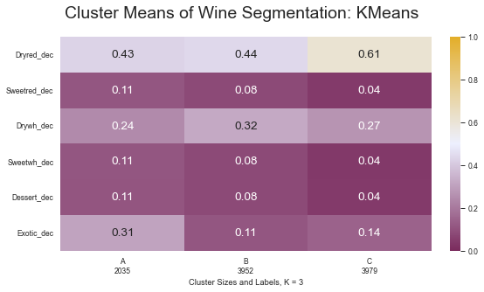

Slide 10
Value and Engagement Segmentation

Slide 11
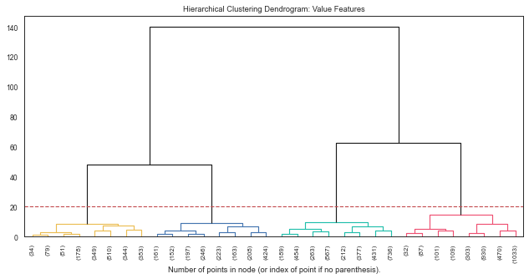

Slide 12
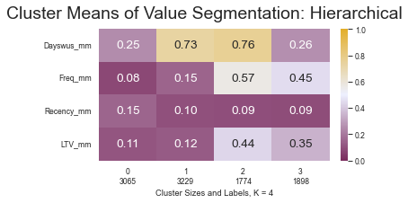

Slide 13
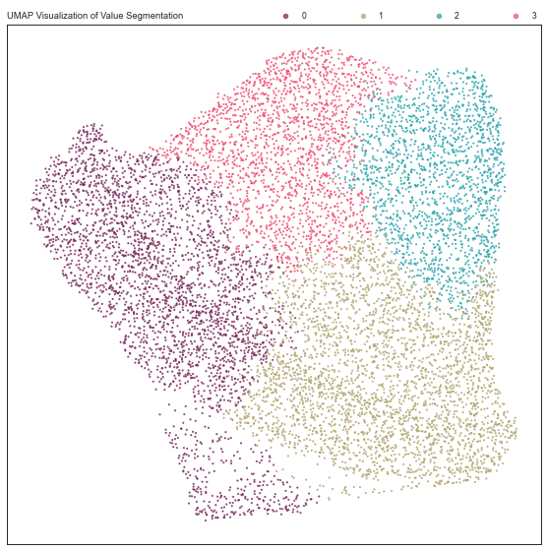

Slide 14
Conclusion

Slide 15
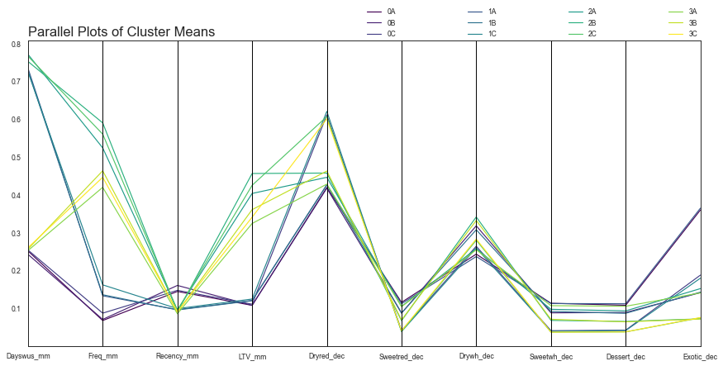

Slide 16

THANK YOU :)

Slide 17
Group X
Marjorie Kinney m20210647
Bruno Mendes m20210627
Lucas Neves m20211020
Farina Pontejos m20210649
Business Cases for Data Science
NOVA Information Management School
March 2022

Slide 19
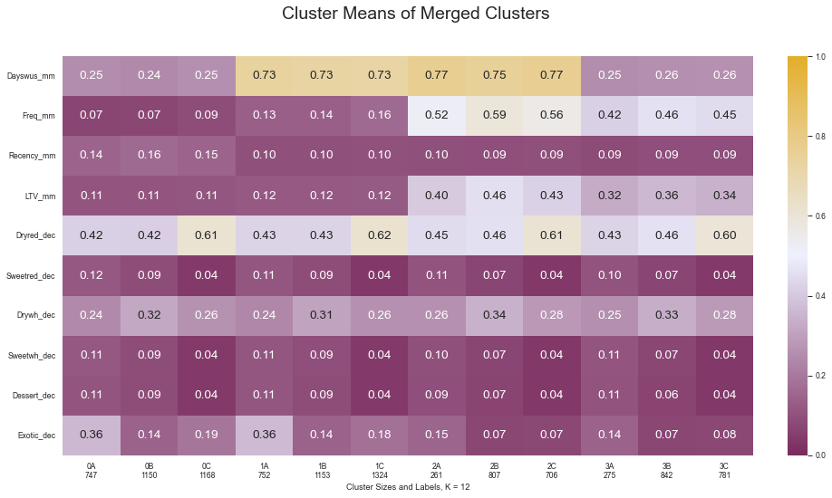

Slide 20
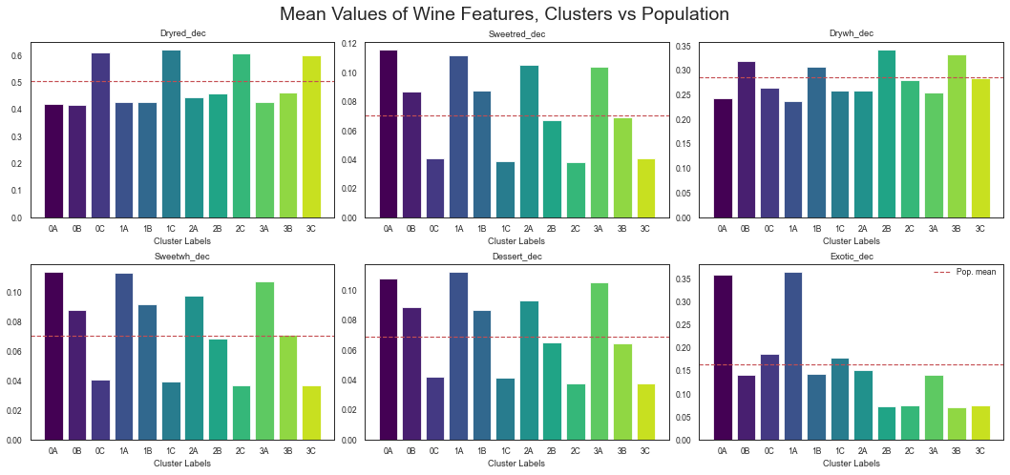
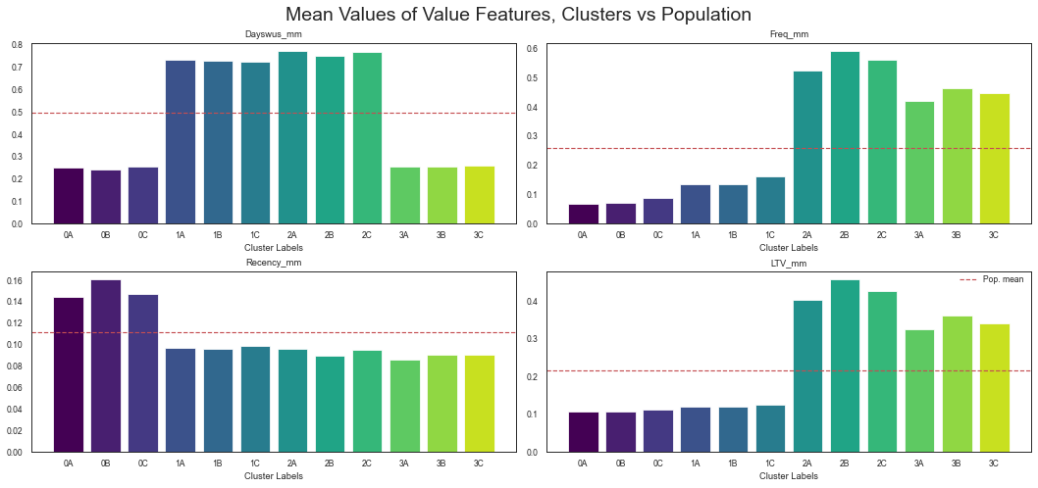

Slide 21
Wine Segmentation Visualization

Slide 22
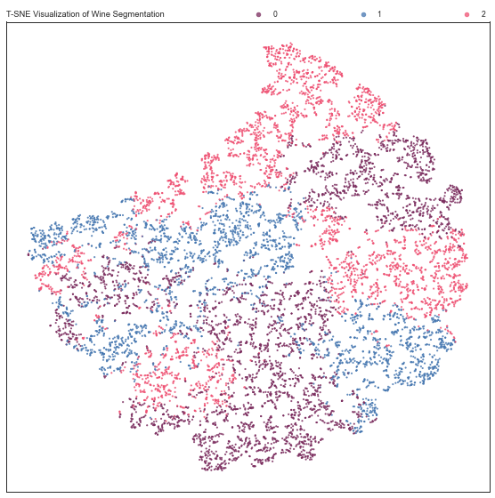

Slide 23
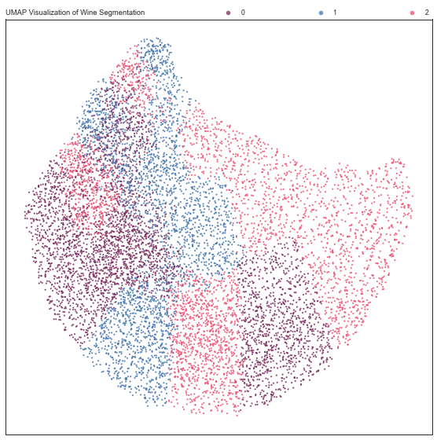

Slide 24
Value and Engagement Segmentation

Slide 25
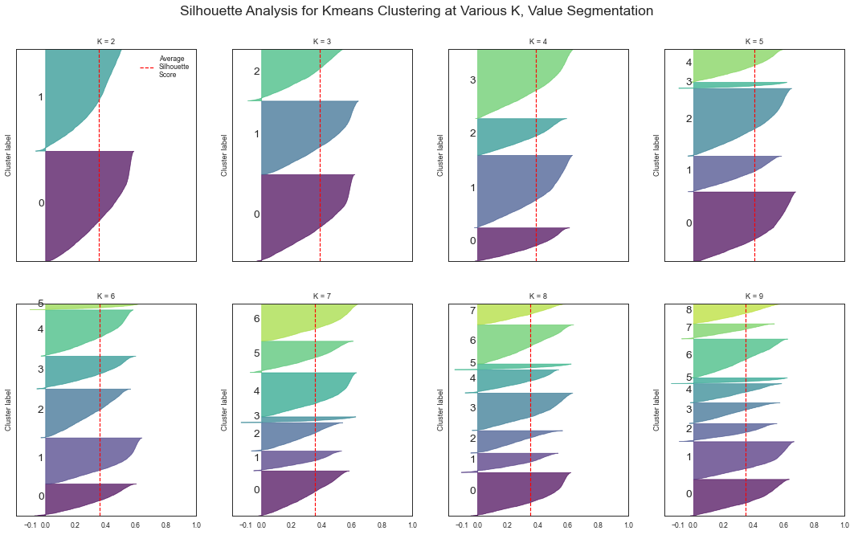

Slide 26
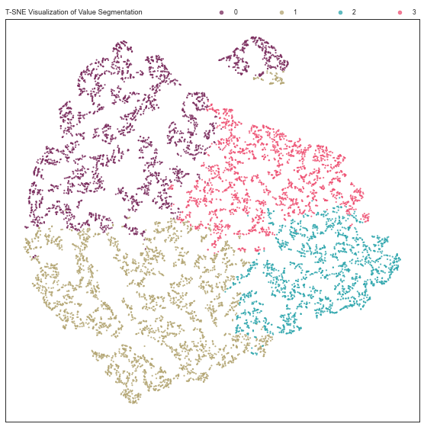

Slide 27
RFM Analysis

Slide 28
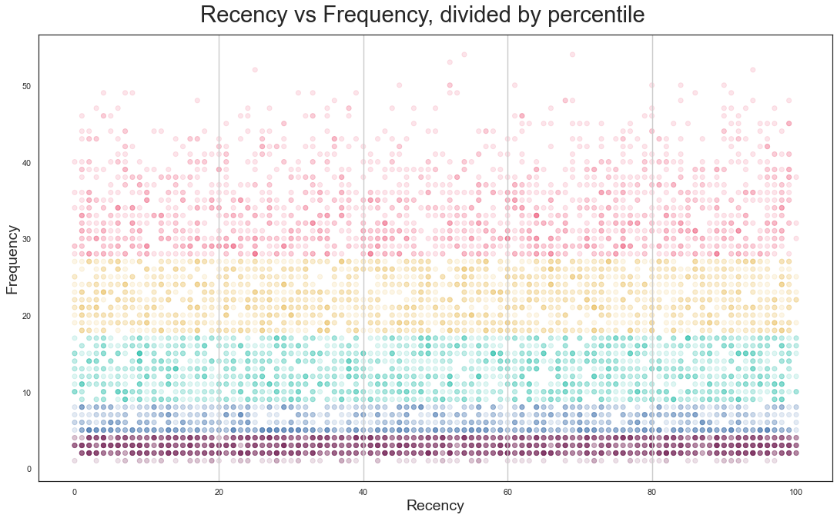

Slide 29
Gold Customers
Loyal Customers
Customers to Recover
Promising Customers
Potentially Loyal Customers
New Customers
Customers About to Hibernate
Customers in Hibernation

Slide 30
Merged Segmentation Visualization

Slide 31
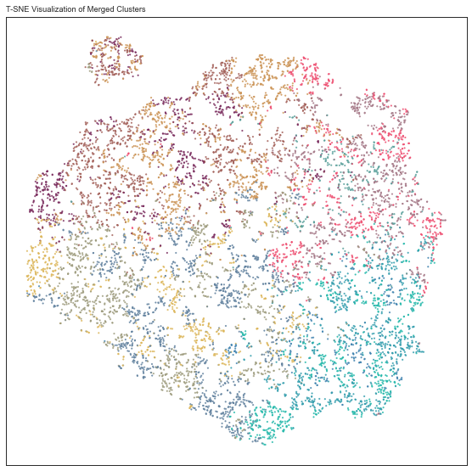
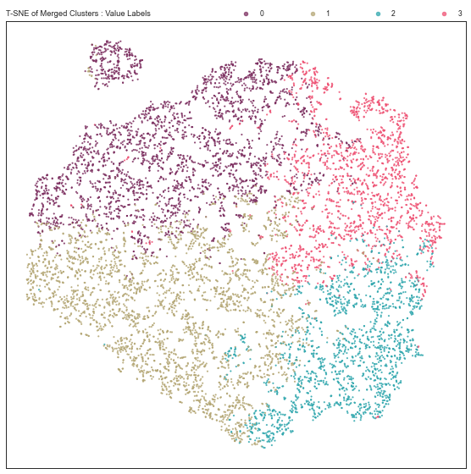
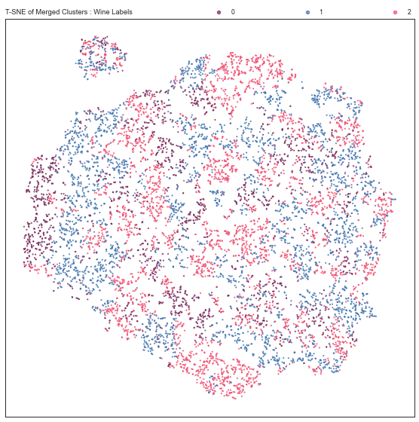

Slide 32
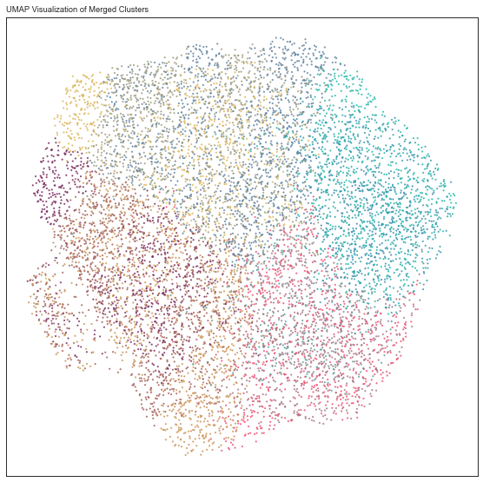
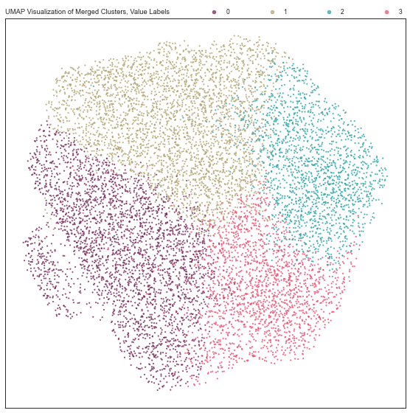
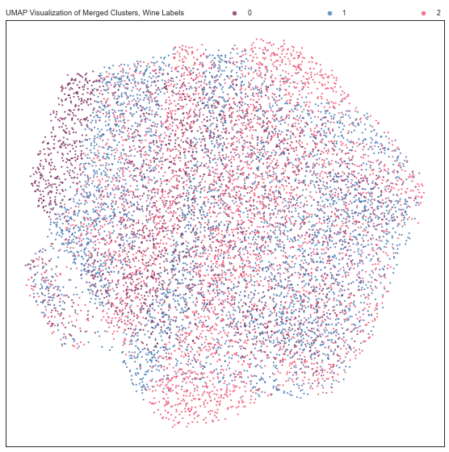

Slide 33
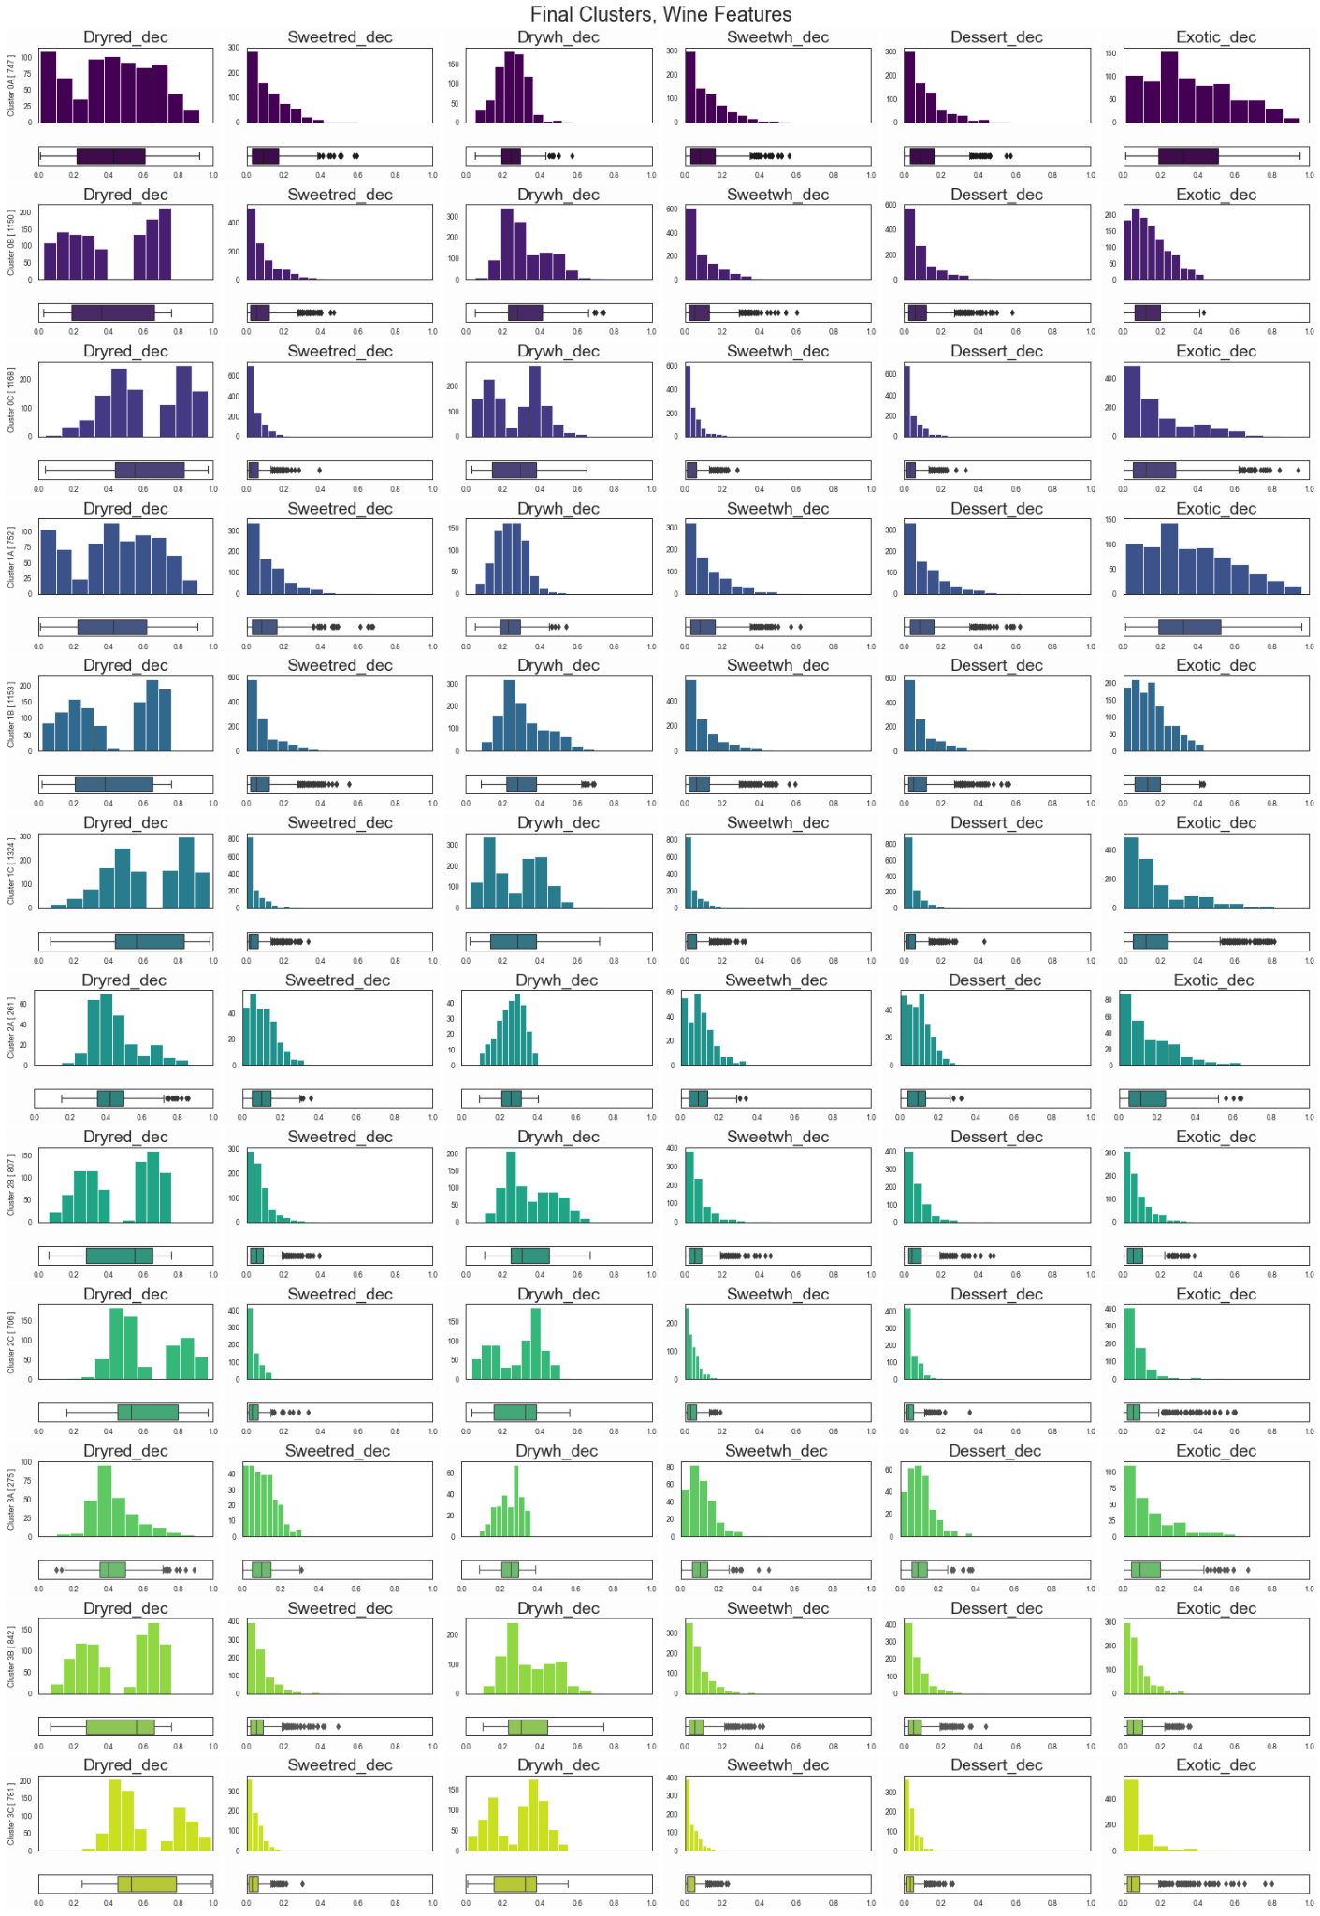
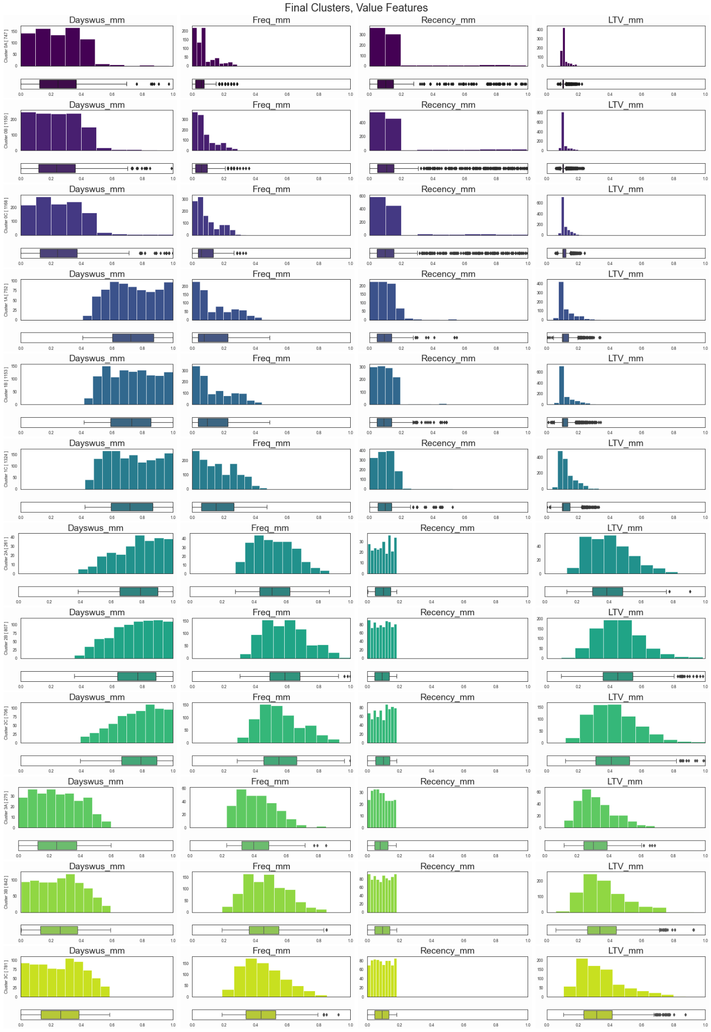

Slide 34
Supplementary Visualizations

Slide 35
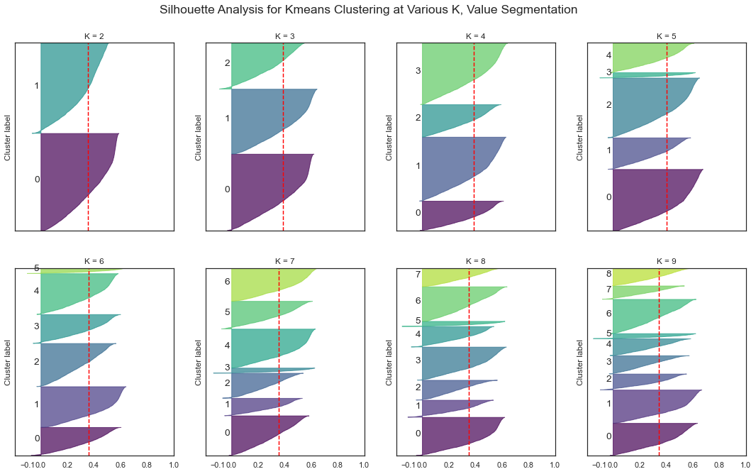

Slide 36
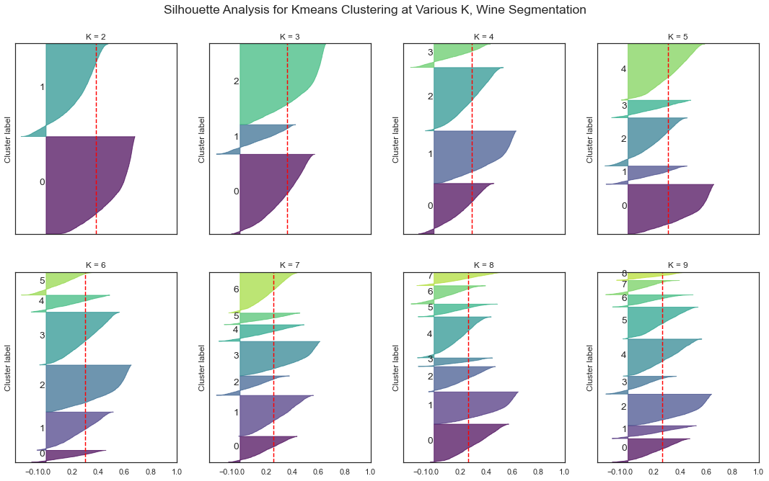

Slide 37
Other Algorithms We Tried

Slide 38
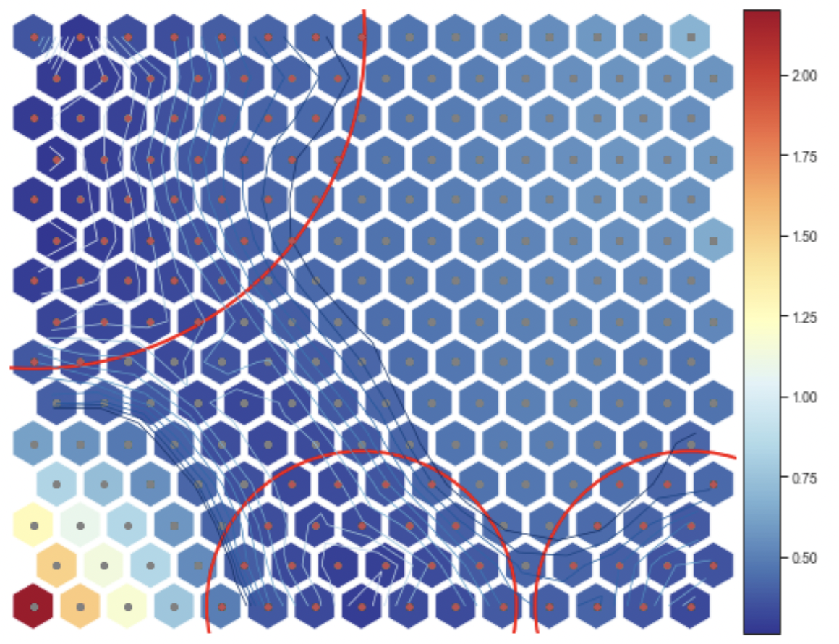
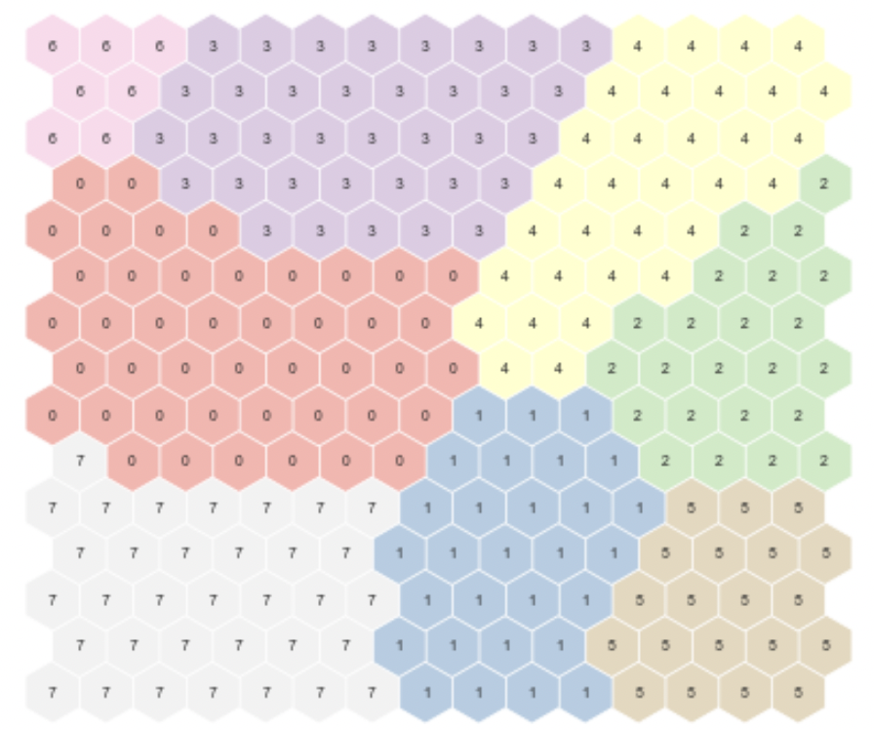
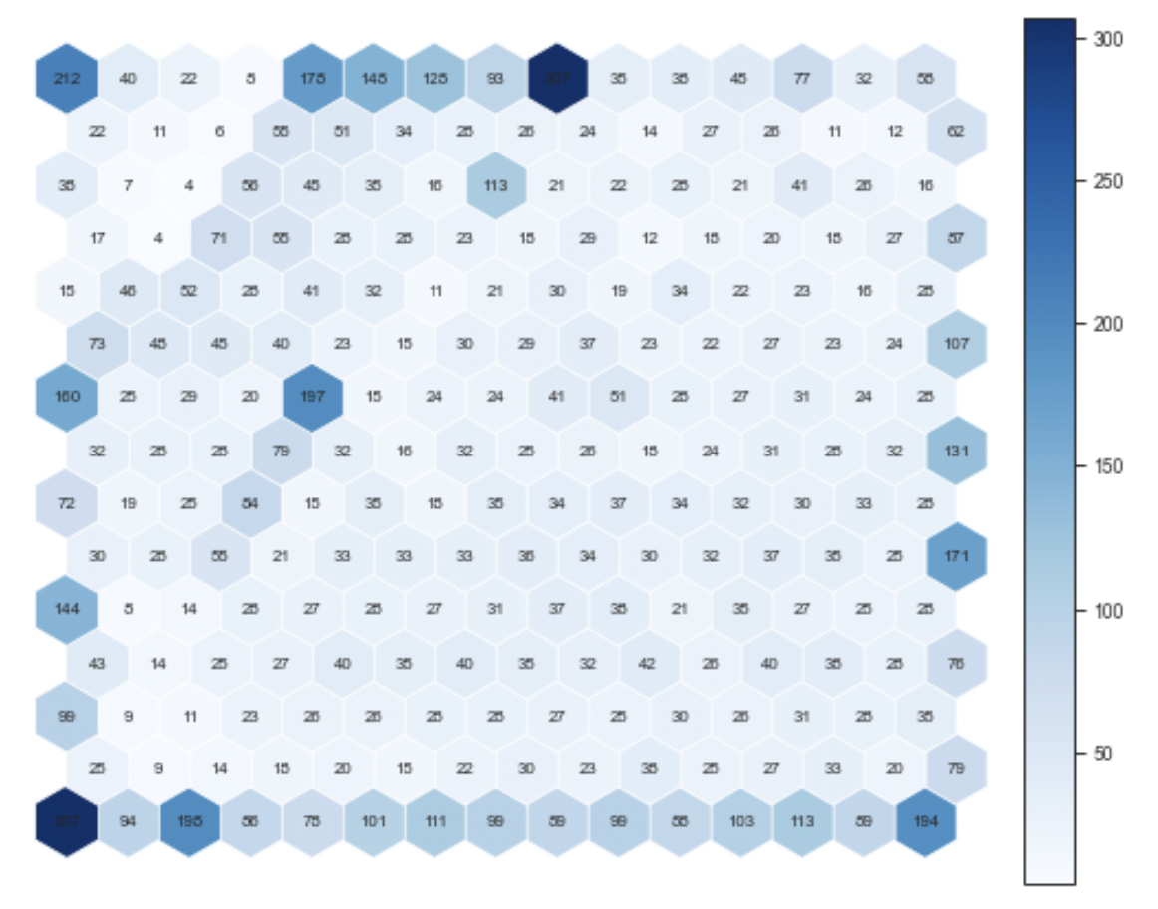
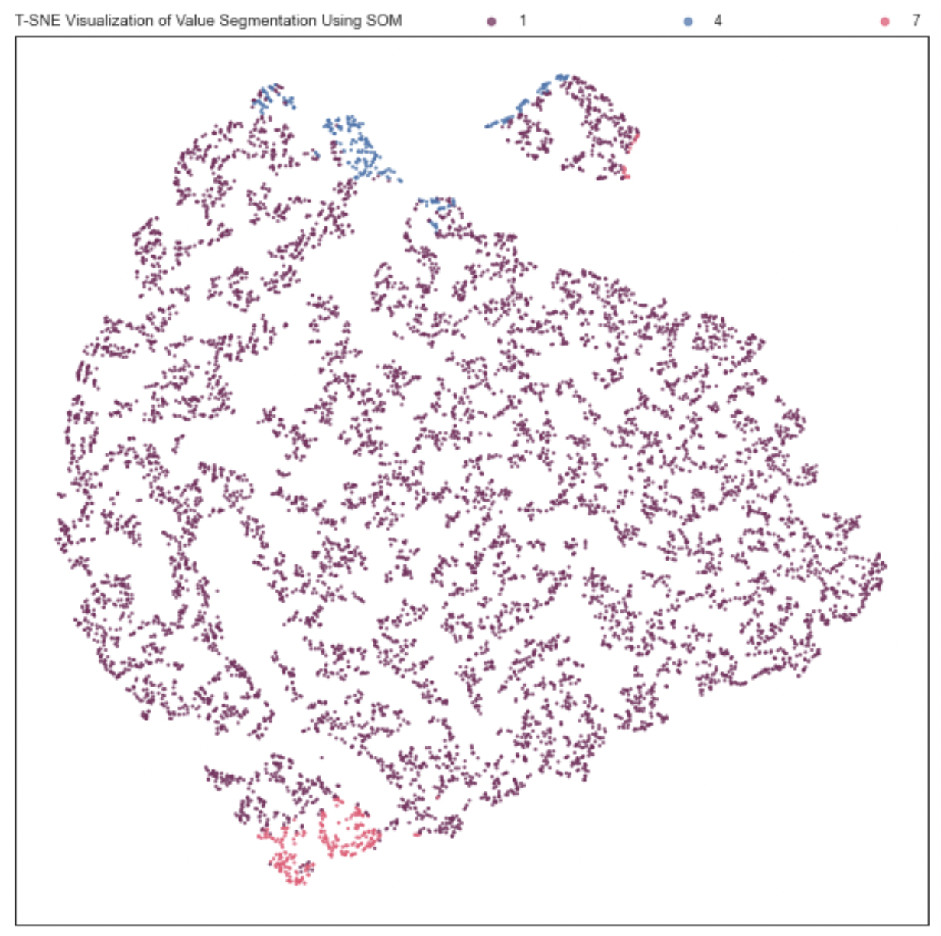
Self-Organizing Maps: Value Segmentation

Slide 39
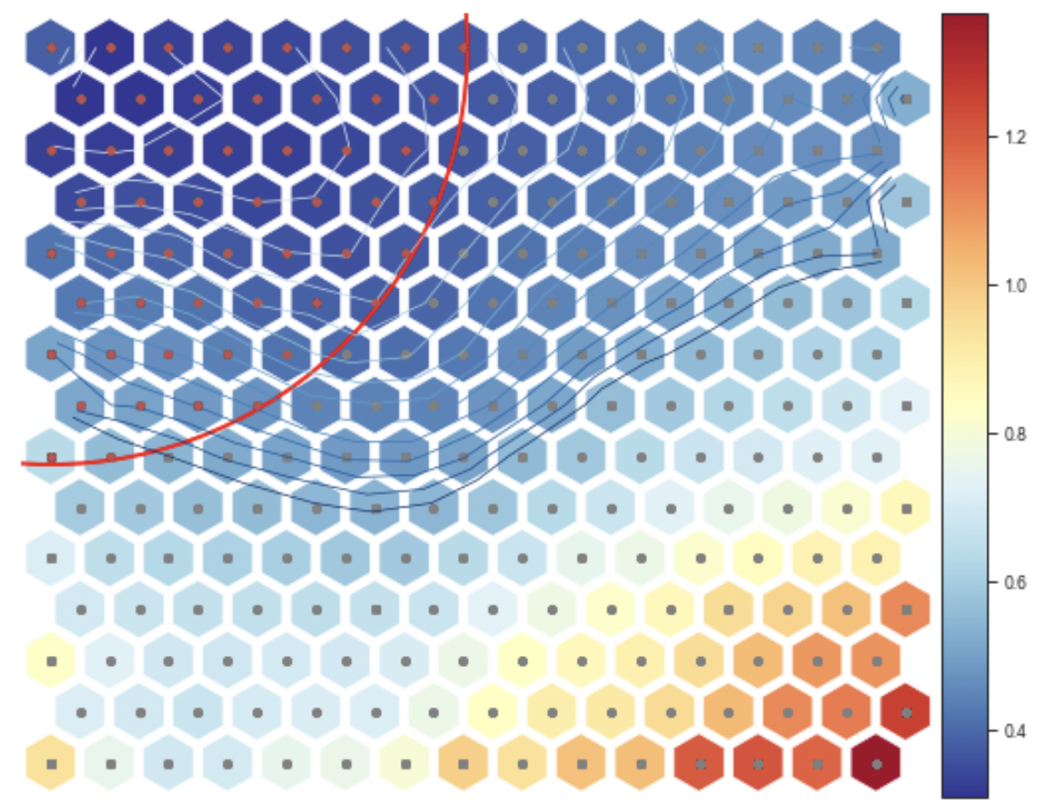
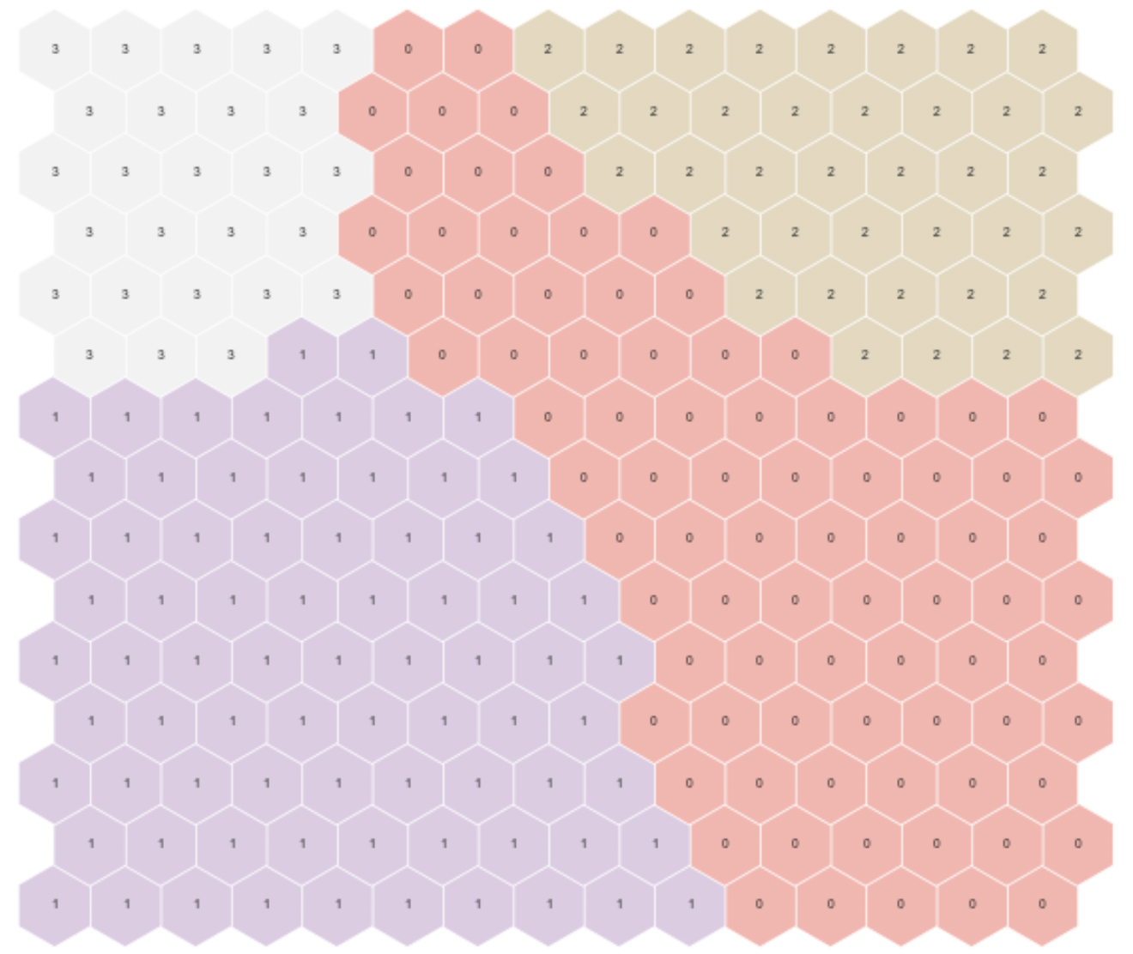
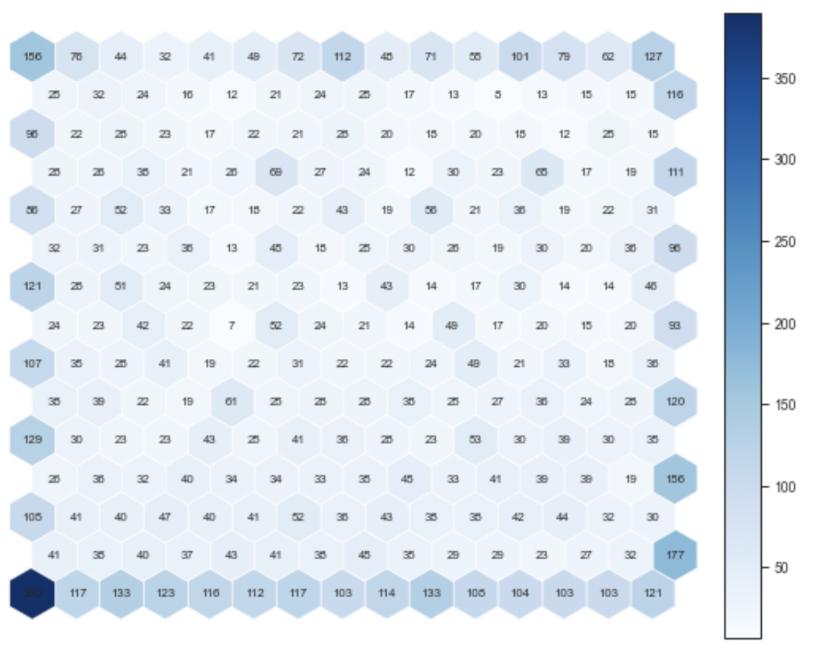
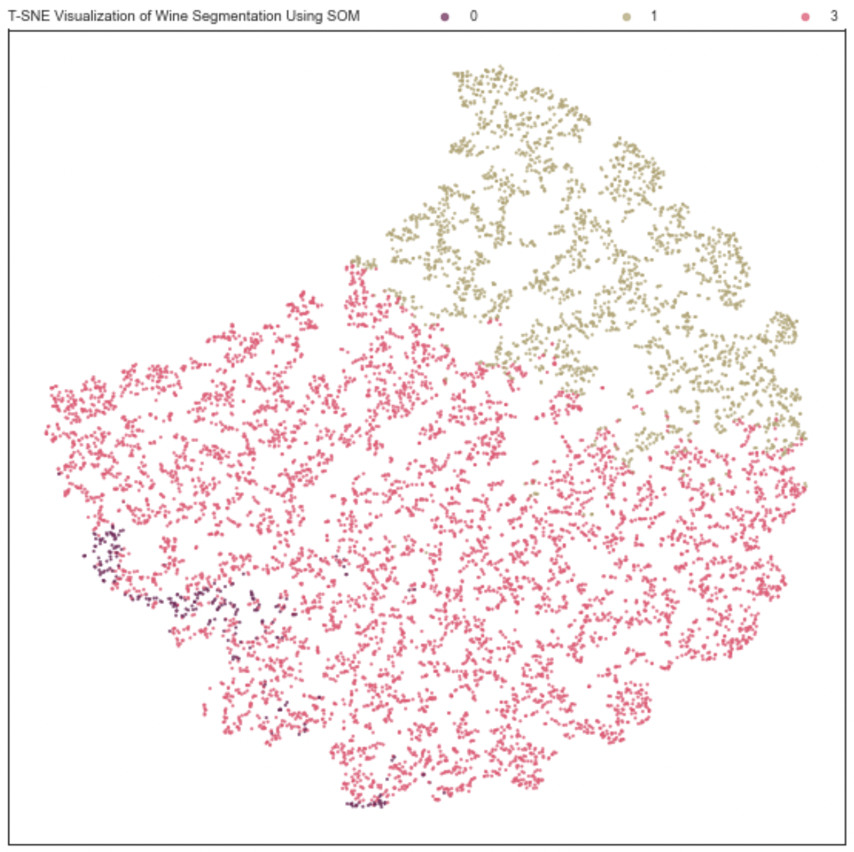
Self-Organizing Maps: Wine Segmentation

Slide 40
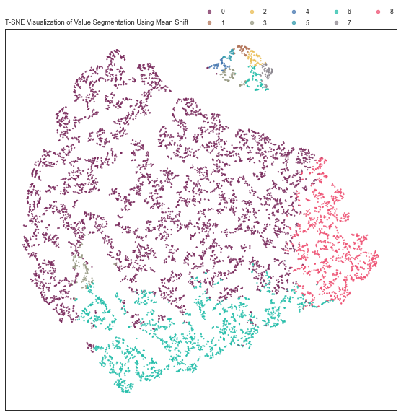
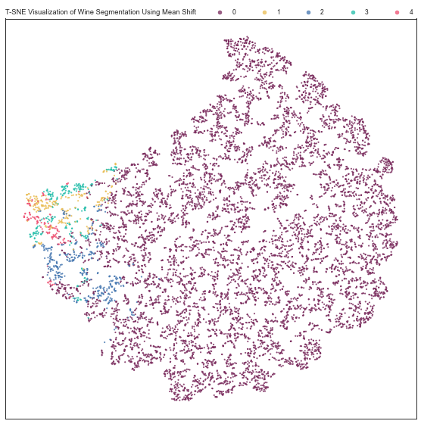
Mean Shift Algorithm

Slide 41
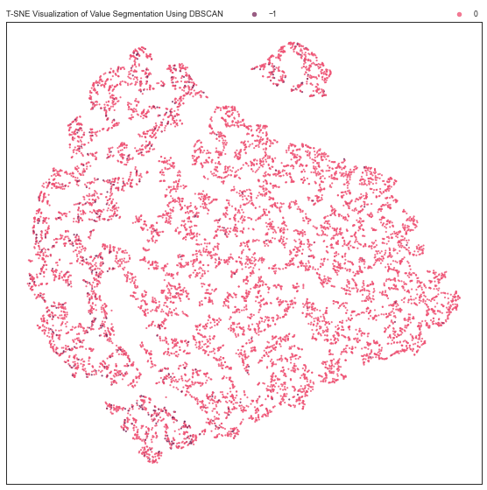
DBSCAN Algorithm

